Slide 1
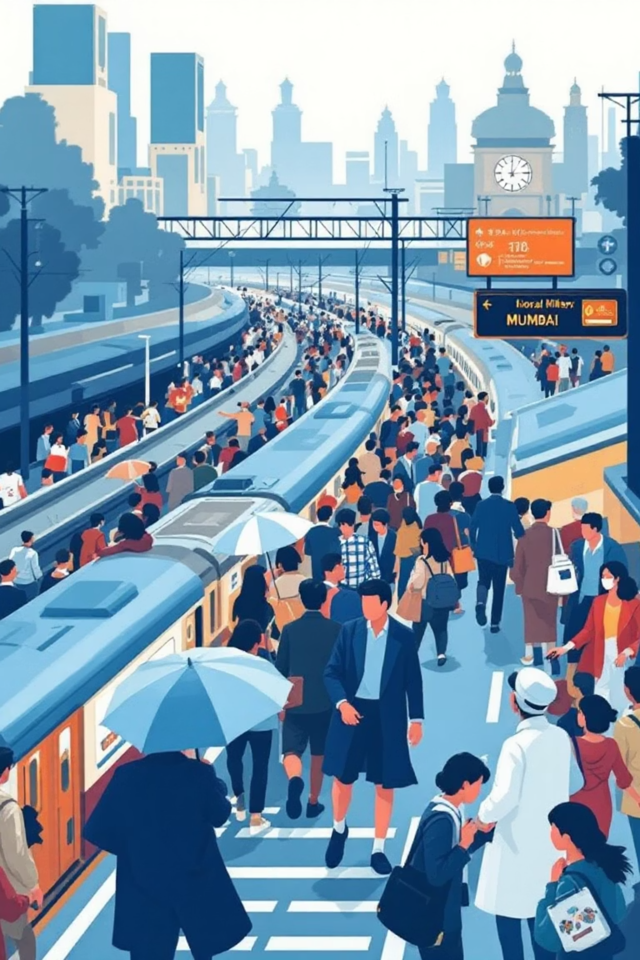
CrowdSense: Real-Time Train Rush Detection App
A Crowdsourced Passenger Input System
Presented by: Aditya Lande

Slide 2
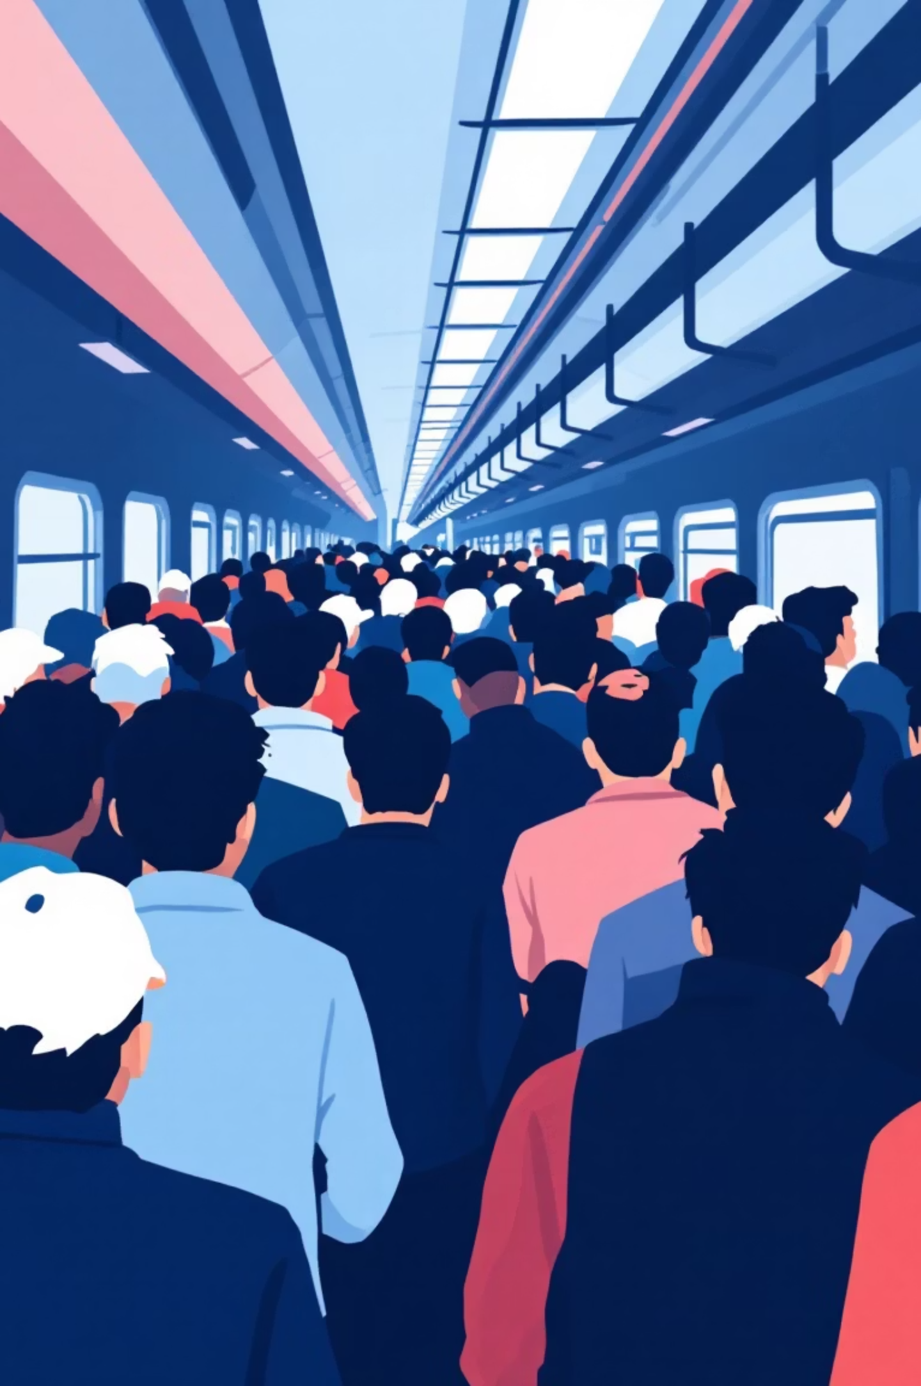
The Unseen Challenge: Mumbai's Crowded Trains
Unpredictable Crowds
Mumbai's local trains face daily, unpredictable rush levels, making daily commutes a significant challenge.
Lack of Real-Time Data
Passengers currently lack any real-time visibility into the current crowding status of a train before it arrives.
Limited App Functionality
Existing transport applications fail to provide crucial coach-level or even station-level congestion insights.
Need for Low-Cost Solutions
There's a critical need for an affordable system that can deliver real-time rush data without requiring expensive hardware or complex satellite tracking.

Slide 3
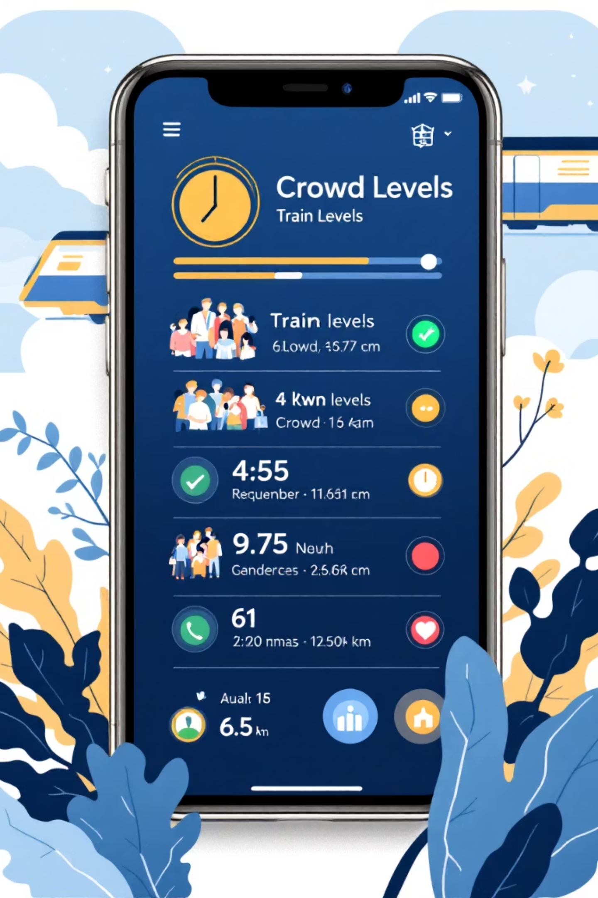
CrowdSense: Our Innovative Solution
Simple Passenger Input
1
A user-friendly mobile app enables passengers to quickly submit a "Yes" or "No" to indicate if their train is crowded.
Dynamic Rush Score
2
The system intelligently calculates a "Rush Score" based on the aggregated total of user votes, providing an accurate measure of crowd density.
Intuitive Visual Cues
3
The app visually represents crowding with a clear Green, Yellow, or Red indicator for each train and time slot.
Crowdsourced Efficiency
4
Operating entirely on crowdsourced passenger input ensures a low-cost, low-complexity solution without the need for expensive infrastructure.

Slide 4





The CrowdSense Workflow: From Vote to Visualization
Select Route & Time
Users first select their Station, Direction, and Time of travel within the app.
Submit Rush Status
A simple tap allows users to submit their real-time "Yes" (crowded) or "No" (not crowded) vote.
Real-Time Data Storage
The submitted vote is instantly stored in Firebase, ensuring data is available for immediate processing.
Rush Score Calculation
The system automatically calculates the Rush Score: (Yes Votes / Total Votes), providing a quantitative measure.
Crowd Level Display
The app then displays the current crowd level using a clear, color-coded indicator for easy interpretation.

Slide 5
Decoding the Rush: Our Indicator Logic
The CrowdSense app provides an intuitive visual guide to train crowding, making it easy for commuters to understand conditions at a glance.
Rush Score < 0.3
🟢 Low Rush
Comfortable travel, plenty of space.
0.3 – 0.7
🟡 Medium Rush
Moderate crowding, standing room available.
> 0.7
🔴 High Rush
Very crowded, limited space.
Simple
Real-time
Scalable
Easy to understand and use for all passengers.
Data updates immediately as votes come in.
Handles increasing user base and data volume effortlessly.

Slide 6
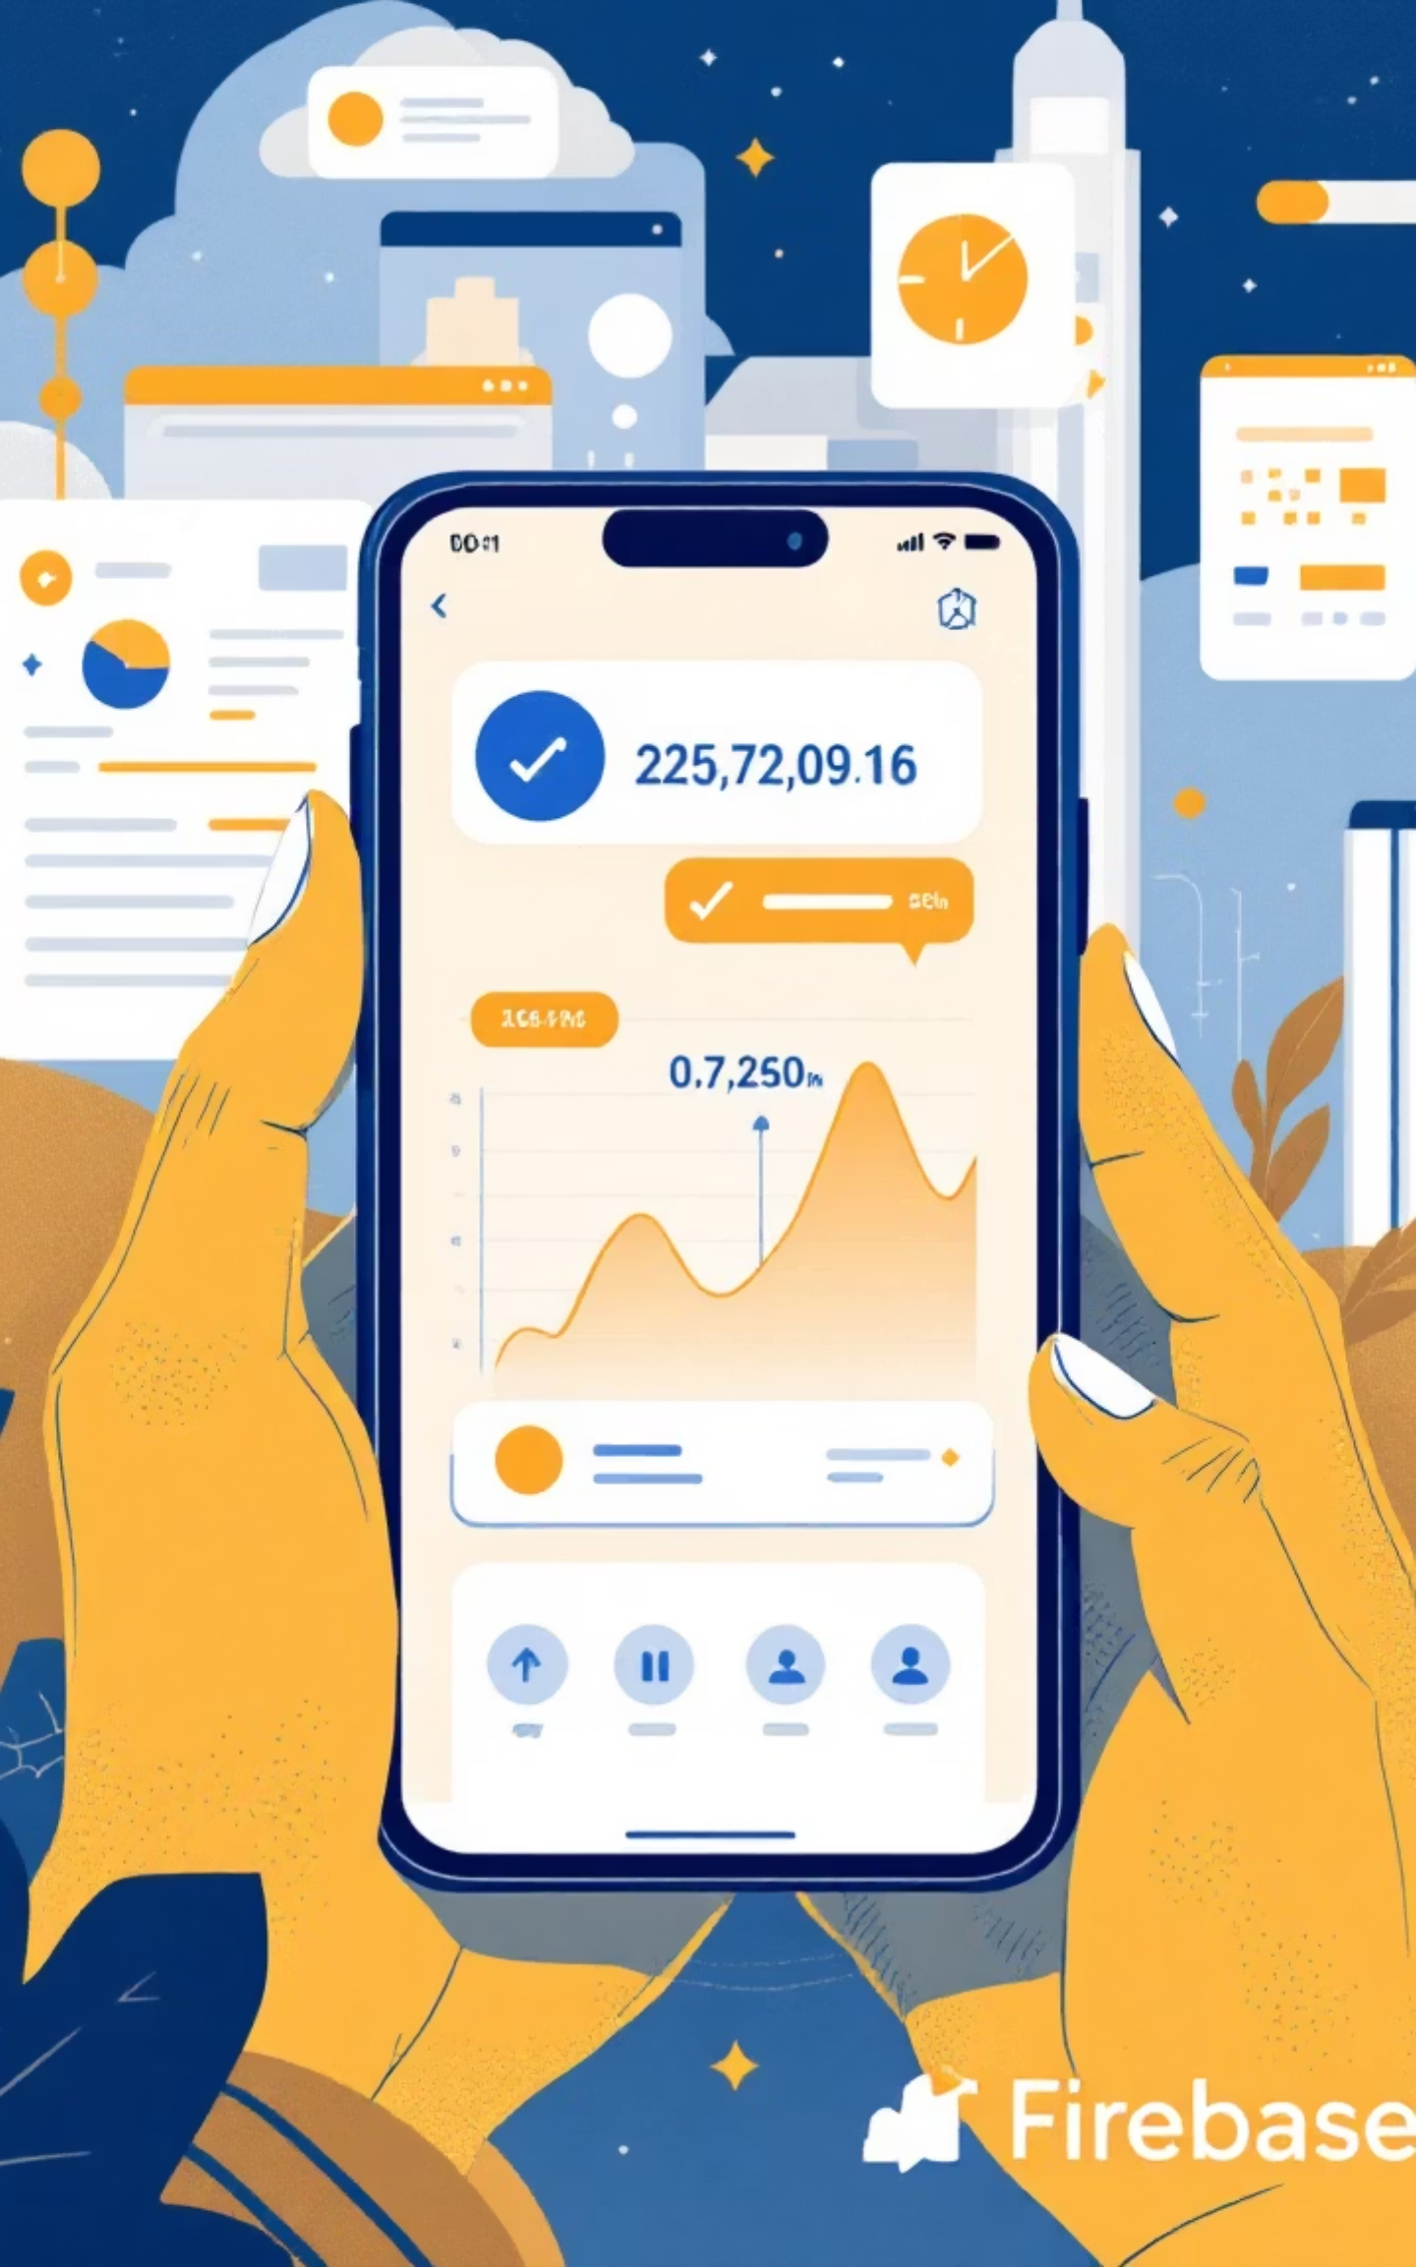

Under the Hood: System Architecture
CrowdSense leverages modern, efficient technologies to deliver a seamless user experience and robust data processing.
Frontend: Mobile App
Flutter / React Native
Output: Heatmap & Colors
Real-time Rush Detection
Backend: Firebase
Live rush visualization
Firestore data store
Processing: Rush Score
Input: Passenger Votes
Real-time calculation
Y/N crowd indicators
This architecture ensures rapid data flow and reliable performance, crucial for real-time applications in dynamic environments.

Slide 7

Data Foundation: Database Structure
Our Firebase Firestore database is designed for efficiency, real-time updates, and scalability, perfectly suited for dynamic crowdsourcing.
trainRush / └── stationName / └── up / └── 10:00 AM / ├── yes: 12 └── no: 5
This structure is incredibly clean, lightweight, and supports real-time updates, ensuring passengers always see the most current information. Each station has entries for different directions (e.g., "up" or "down") and time slots, further broken down by "yes" and "no" votes.

Slide 8





Empowering Commuters: Core Features
CrowdSense is built with practical features designed to enhance the daily commute and provide reliable crowd information.
Submit Rush Status
Real-time Indicators
Station Visualization
Simple "YES/NO" input for quick, on-the-go crowd reporting.
Instant updates on train crowd levels using a color-coded system.
View crowding across different stations and specific time slots.
Anti-spam Mechanism
Optional: Image AI
Ensures data integrity with a "one vote per user per 10 minutes" rule.
Future add-on for image-based crowd detection to supplement votes.

Slide 9





Beyond Today: Future Scope & Enhancements
CrowdSense has significant potential for growth, integrating advanced technologies to offer an even more comprehensive solution.
Predictive Forecasting
AI Image Analysis
Develop algorithms to predict future crowd levels based on historical data patterns and real-time trends.
Implement AI to automatically analyze uploaded passenger images for crowd density, complementing manual inputs.
Travel Recommendations
API Integration
Provide personalized suggestions for less-crowded alternative routes or travel times.
Connect with official railway APIs to pull live train timings, enhancing accuracy and user convenience.

Slide 10




CrowdSense: A Smarter Commute for All
CrowdSense offers an innovative and practical approach to a common urban challenge, proving the power of crowdsourcing for public good.
Cost-Effective
Enhanced Planning
Utilizes user-generated data, eliminating the need for expensive sensors or satellite infrastructure.
Empowers commuters to plan their travel more efficiently, reducing stress and improving their daily experience.
Strong Application
Demonstrates a robust blend of practical utility and sound technical understanding in its design.

